Slide 1
Malicious Url Detection
Archit Kumar
Aman Agrawal
Souparna Das
Rajneesh Singhatiya

Slide 2
Why Malicious Url Detection ??
Malicious Web sites are a cornerstone of Internet criminal activities. They host a variety of unwanted content ranging from spam-advertised products, to phishing sites, to dangerous "drive-by'' exploits that infect a visitor's machine with malware. As a result, there has been broad interest in developing systems to prevent the end user from visiting such sites.

Slide 3
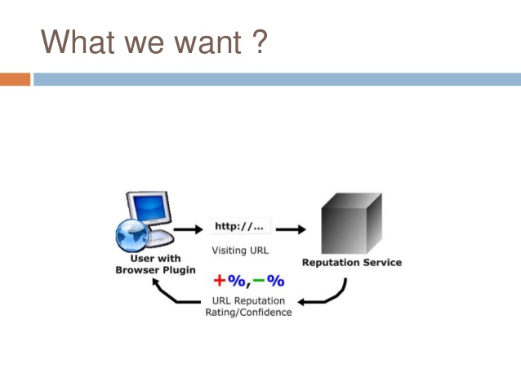

Slide 4
Two approach to deal with problem :
The static approach aims to detect malicious websites by analyzing their URLs or their contents . This approach is very efficient and thus can scale up to deal with the huge population of websites in cyberspace. This approach however has trouble coping with sophisticated attacks that include obfuscation and thus can cause high false-negative rates by classifying malicious websites as benign ones.
The dynamic approach aims to detect malicious websites by analyzing their run-time behavior using Client Honeypots or similar systems . Assuming the underlying detection is competent, this approach is very effective. This approach however, is inefficient because it runs or emulates the browser and possibly the operating system . As a consequence, this approach cannot scale up to deal with the large number of websites in cyberspace.

Slide 5
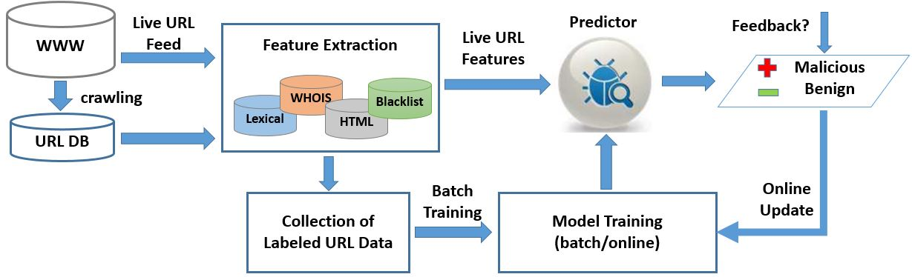
Machine Learning

Slide 6
Data Features
Url_length Redirect average_string_length
Special_character_count protocol max_len_strings
Data_time strings_above_avglength server_name
Having_ip_address http_status_code whois_country
Dns_response_time iframe_count whois_city
Handshake_time scripts_count registration_date
Number_of_redirect external_link_count last_updated
Data length total_strings_count expiry_date

Slide 7
Features extraction in detail :
Static Features :
URL Length : malicious URLs often include automatically and dynamically generated long random character strings.
Having _IP_ADDRESS in URL : Some websites use IP addresses instead of domain names in the URL because the IP addresses represent the compromised computers that actually do not have registered domain names.
DNS_respose_time : Benign URLs often have longer lifetimes and their domain names are more likely cached at local DNS servers. As a result, the average value of this feature may be shorter for benign URLs.

Slide 8
……...
handshake_time : handshake time between client and server. Malicious urls generally have large handshake time.
RegDate and Updated_date. These two features are closely related to each other. They indicate the dates the web server was registered and updated with the Whois service, respectively.
Country and Stateprov. These two features respectively indicate the counter 8 and the location where the website was registered .
protocol : servers that are heavy on dynamic content tend to be impacted less by HTTPS because the time spent encrypting (SSL-overhead) is insignificant compared to content generation time.

Slide 9
Handling dynamic web pages
Issues in dynamic web pages :
Dynamic web pages usually first load javascript code in the browser , then other content is loaded using javascript .
In such web pages any web crawler can only access the javascript code of the web pages , not the content that was loaded by that javascript.
Therefor to handle such scenario we need to load web page first in a browser window and then fetch its content .
We used selenium api with chrome driver to handle dynamic performance of a webpages .

Slide 10
……...
Features which required dynamic handling :
scripts_count : no. of javascripts. JavaScript functions are often used by attackers to obfuscate their code and bypass static analysis. For example, eval() can be used to dynamically execute a long string at runtime, where the string can be the concatenation of many dynamic pieces of obfuscated substrings at runtime; this makes the obfuscated substrings hard to detect by static analysis. Script plays a very important role in drive-by download attack.
iframe_count : no. of iframes in web . If any iframe contains malicious code, the URL is malicious. A small size iframe is even more harmful because it imports malicious content that is invisible to the users.
external_link_count : no. of external links. This feature can be indicative of malicious URLs because external URLs are often abused by attackers to import malicious content to hacked URLs

Slide 11
……...
Total_strings_count ( no. of strings in javascript ), Average_string_length , max_len_strings , strings_above_avglength - Because attackers try to encode malicious script code into a string and then use it to execute in client browser, these features can be indicative of malicious URLs.
redirect : tells whether this url redirected to some other url or not .

Slide 12
What else can we use ?
These features were not possible to extract due to system requirements and to extract these features we need some safe system like : honeypots.
Unluckily these were also the features which showed highest importance in the dataset(2).
NETWORK LAYER BASED FEATURES :
App_bytes. This is the number of Bytes of the application-layer data sent by the crawler to the remote web server, not including the data sent to the DNS servers. Malicious URLs often cause the crawler to initiate multiple requests to remote servers, such as multiple redirections, iframes, and external links to other domain names.
Source_app_packets. This is the number of packets send by the crawler to remote servers .
TCP_CONVERSATION_EXCHANGE: This variable is the number of TCP packets exchanged between the server and honeypot client .
APP_PACKETS: this is the total number of IP packets generated during the communication between the honeypot and the server

Slide 13
……...
PAGE BASED FEATURES :
Global Pagerank Country Pagerank
Position at the Alexa Top 1 Million Site
Estimated Number of Visits for the domain on a daily, weekly, or monthly basis
Average Pageviews per visit Category of the domain
Average Visit Duration Web traffic share per country
Count of reference from Social Networks to the given domain
*These are the paid services provided by third party api.

Slide 14
……...
OBFUSCATED JAVASCRIPT (still an open problem) :
Malicious javascript often utilizes obfuscation to hide known exploits and prevent rule-based or regular expression (regex)-based anti-malware software from detecting the attack. The complexity of obfuscation techniques has increased, raises the resources necessary to deobfuscate the attacks
ISSUES : labelling javascript good or bad is a challenging problem. It required domain expertise. Training a machine learning model over an code is also quite complex.
Including such features will significantly improve our model accuracy.

Slide 15
Handling Missing values
Following approaches were -
Introducing another category (registration date,expiry date , last_updated , server name,...)
Removing data point if missing values count is too small (redirect ,...)
Using 0 value (handshake time ,data time , data length,..)

Slide 16
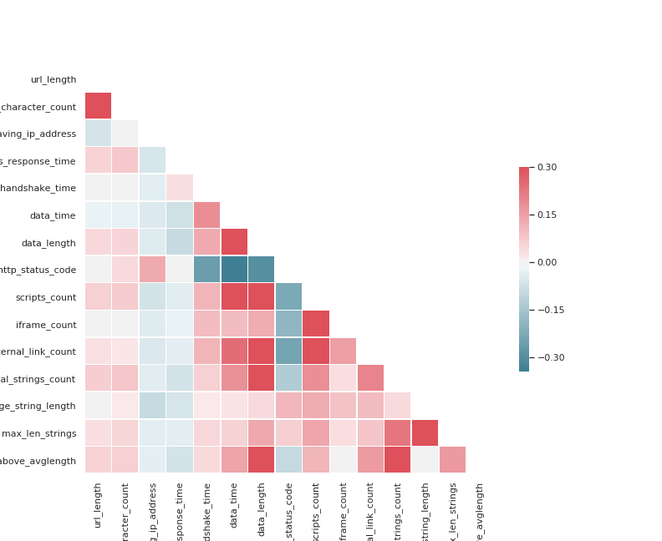
Data Analysis -
Correlation matrix to find relation between two variables of the data.
When correlation is red(positive) increasing one variable will increase other variable and blue means increasing one decreases other.

Slide 17
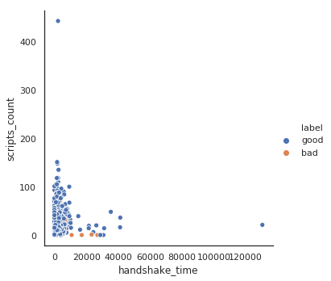
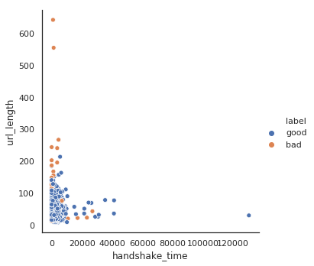
The left graph shows dependence of label on two variables, namely url_length and handshake time. The right graph shows dependence of label on scripts_count and handshake_time.

Slide 18
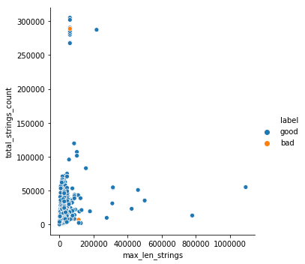
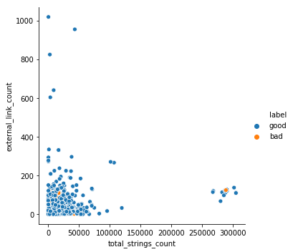
Left graph shows dependence of label on total_strings_count and max_len_strings. Right graph shows dependence of label on external_link_count and total_string_count.

Slide 19
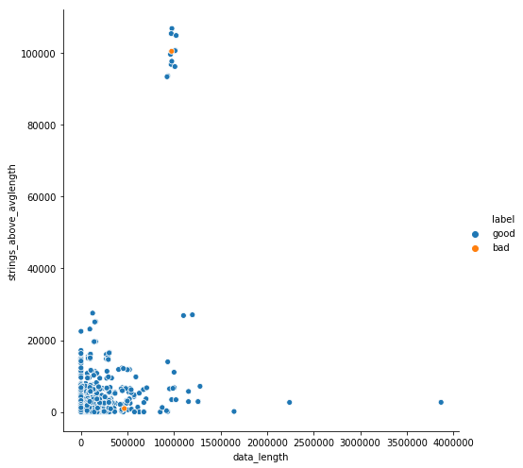
The left graph shows dependence of label on data_length and strings_above_avglength and the right graph shows dependence of label on scri[ts_count and handshake_time.

Slide 20
Models used -
Data is trained and tested on various machine learning models to know which model suitably interprets data.
SVM (Linear)
SVM (Kernel)
Logistic Regression
Random Forest
K-NN (Baseline)

Slide 21
SVM
Used “class weights” to balance imbalance classes.
Recall is important (why ?).
Linear SVM gave better recall.
Changed Value of “C” to check regularization.
AuROC value = 0.77
Other performance measures:
 | precision | recall | f1-score | support
BAD URL | 0.45 | 0.70 | 0.55 | 71
GOOD URL | 0.95 | 0.87 | 0.91 | 457

Slide 22
NeurAl network :
Parameters :
Optimizer : ‘lbfgs’ is an optimizer in the family of quasi-Newton methods.
Layers Size : (50, 2)
 | Precision | Recall | F1 score | Support
Bad url | 0.41 | 0.43 | 0.42 | 70
Good url | 0.92 | 0.92 | 0.92 | 531

Slide 23
RAndom Forest
Biased if dataset is imbalanced ( Why ?)
Poor recall at first on unseen data (0.28)
Try Grid Search Cross validation
Get best parameters for the training set
Result after grid search:
Best parameters from grid search cv:
1. N_estimators : 459
2. Min_Samples_leaf : 3
3. Min_Samples_split : 3
4. Max_features: “sqrt”
5. Max_depth : 118
6. Bootstrap : True
 | Precision | Recall | Support
Bad URL | 0.51 | 0.87 | 68
Good URL | 0.98 | 0.88 | 460
THE BEST

Slide 24
Logistic Regression
Biased if dataset is imbalanced
Used class_weights to balanced the training set
Solver : “Liblinear” worked, “SAGA” didn’t converge
Significantly “Good” recall.
Checked with different regularization
Results for Logistic
 | Precision | Recall | Support
Bad URL | 0.35 | 0.83 | 69
Good URL | 0.97 | 0.77 | 459

Slide 25
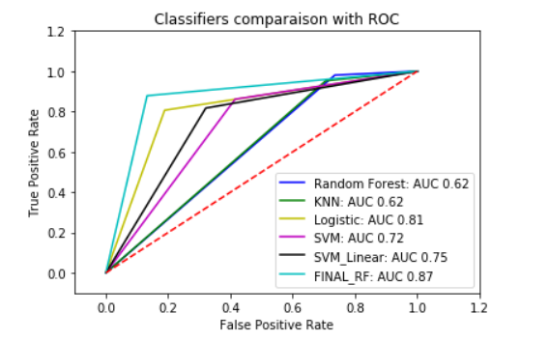
Comparison with AuROC

Slide 26
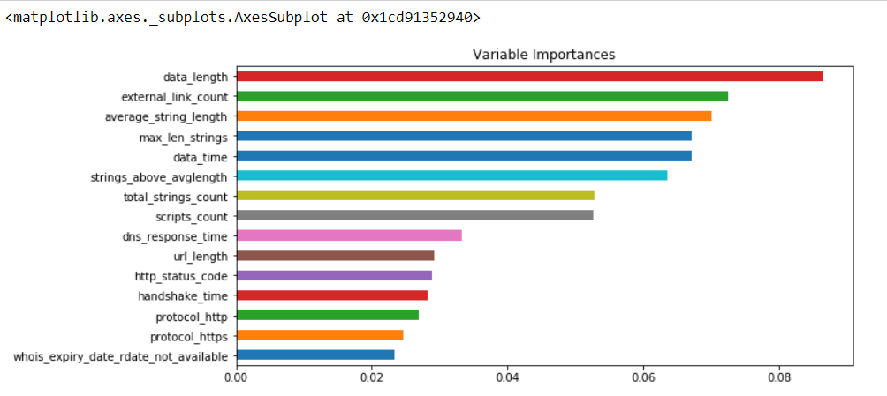
Feature Importances
Top 15 features (Sorted)

